Slide 1
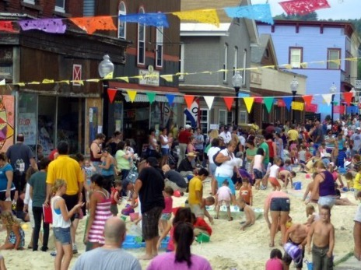
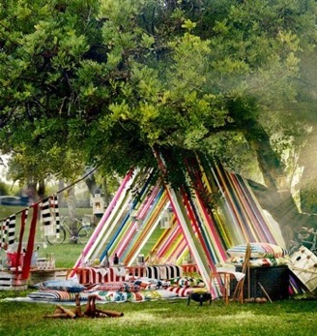
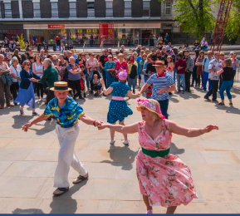
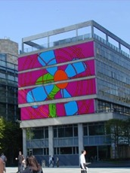
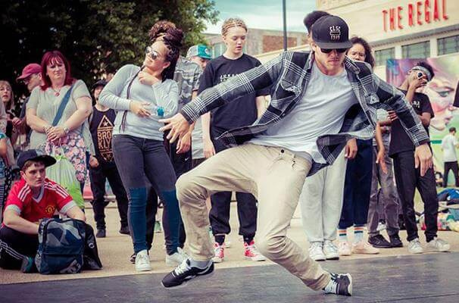
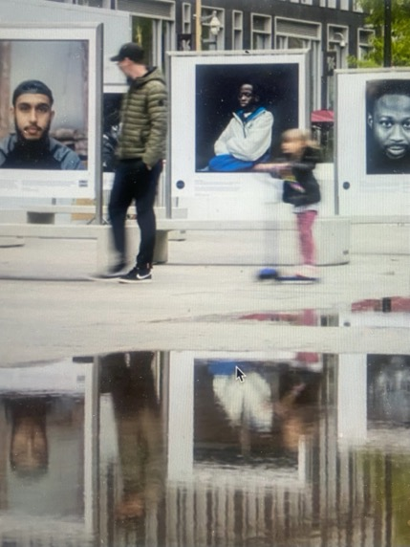
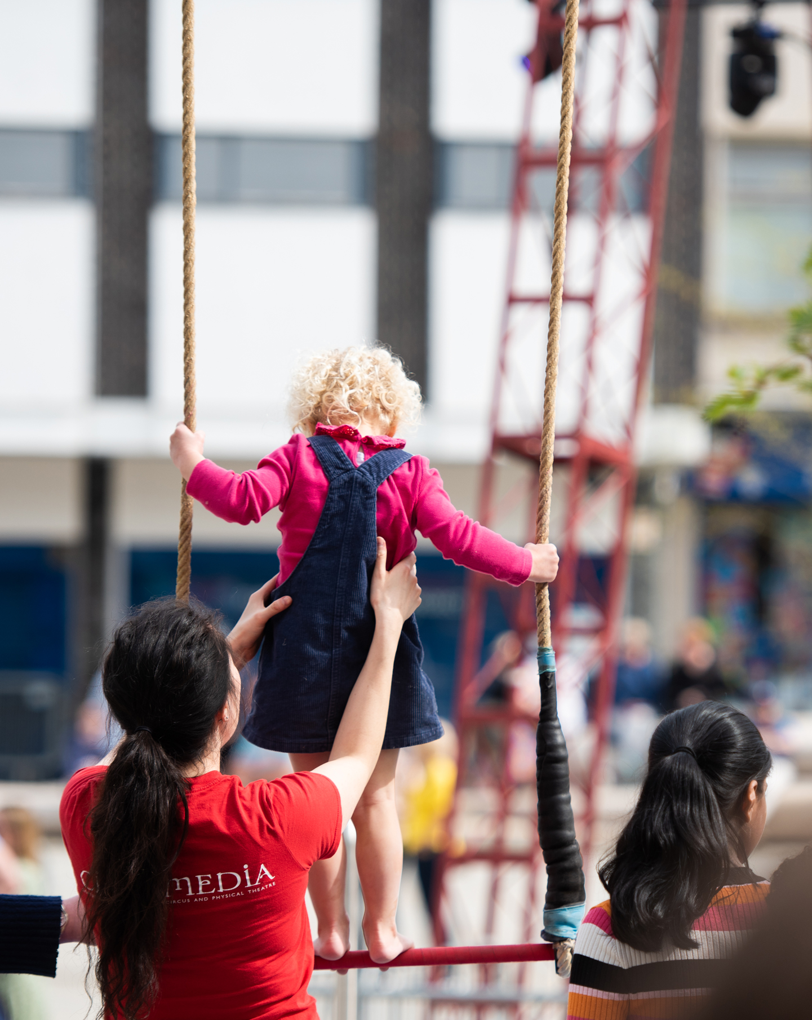
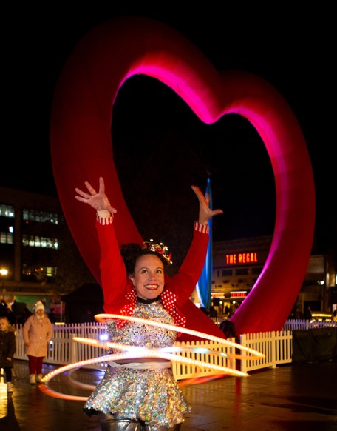
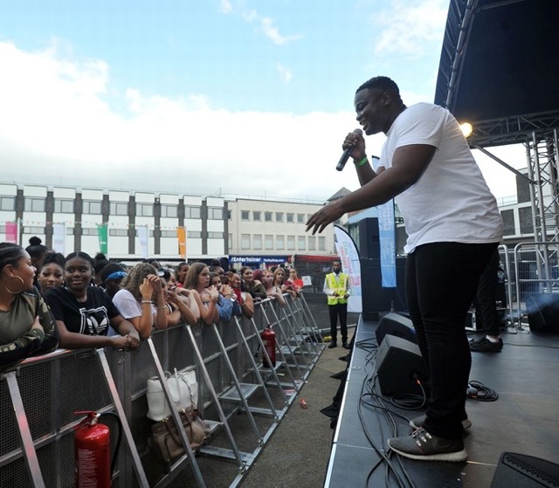
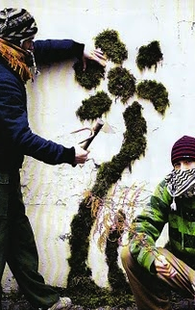

Kings Square Commission brief
2026 - 2027

Slide 2
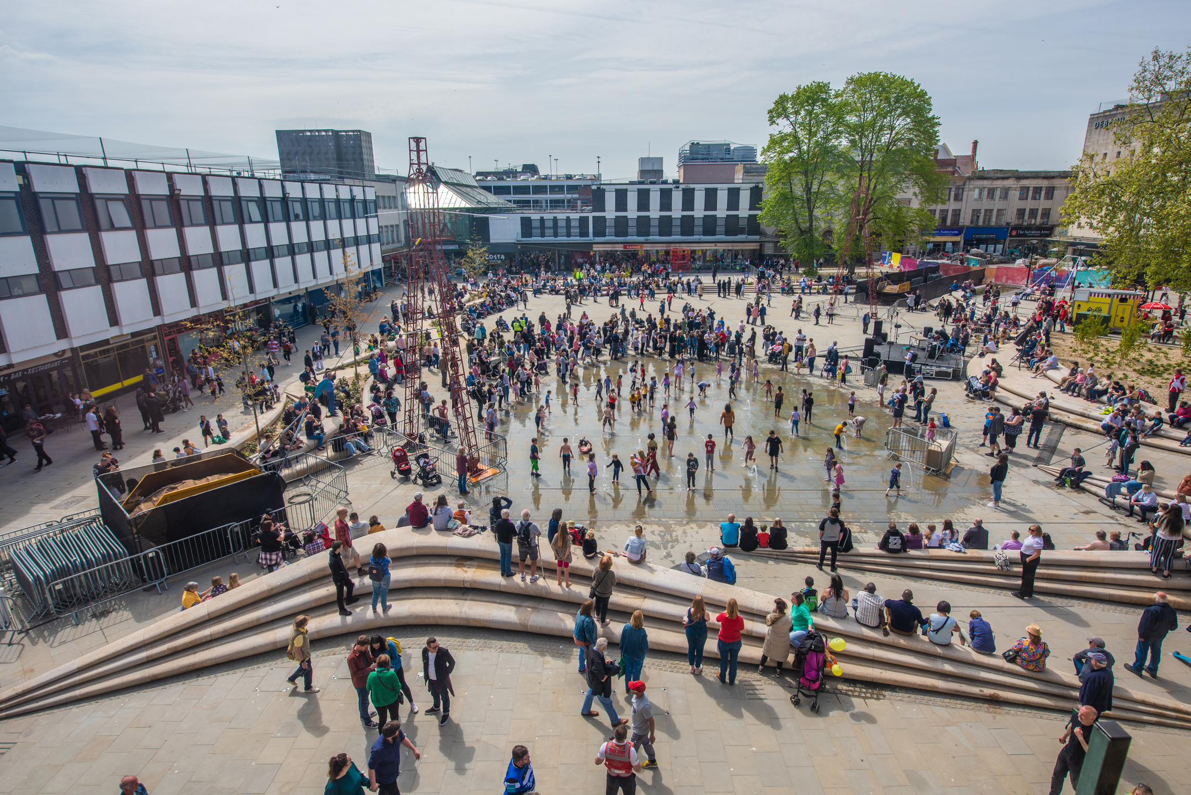
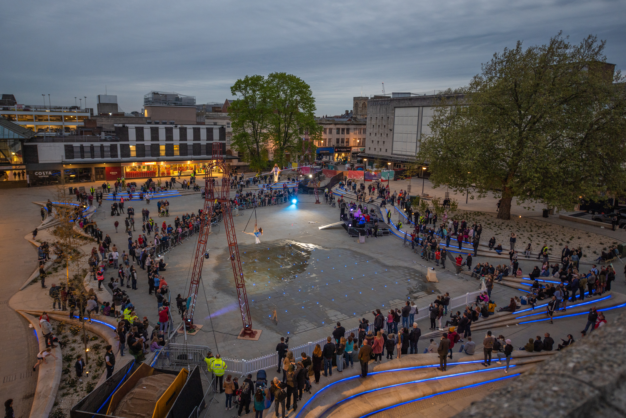
Kings Square Background
Kings Square is a dynamic public space in the city centre and during the summer months the water fountains are a huge draw for young families and local workers. Since its major refurbishment in 2022, it has become a flexible venue for a range of cultural activity, with music playing a central role in shaping its atmosphere and identity. Events have included dance performances, food, live music, exhibitions and cinema screenings. Communities would like to see more regular activity in the square, that brings people together through shared participation.

Slide 3
Together Gloucester 4 Step Changes
Together Gloucester
Empower Gloucester’s citizens to celebrate their identity
Put citizens at the centre of Gloucester’s cultural decision-making process
Improve the health and well-being of communities, supporting cross sector organisations to work together
Make Gloucester a better place to live, work and visit where people know they can engage in fun, cultural activity

Slide 4
We’re commissioning a vibrant series of events in King’s Square that invite people to take part in joyful, creative experiences celebrating Gloucester and its diverse communities.
Rooted in collaboration, this programme will be co-created with local residents, groups and organisations, to reflect the city, encourage participation and leave people feeling happy to be in Gloucester. The programme will be linked by an overall design and made distinctive through the communities that you collaborate with.
Your proposal should include 6 activities/ events that:
Takes place monthly, on the same weekend of the month (where possible)
Is co-created with communities to ensure that it is relevant to Gloucester.
Could include music, dance, performances, food and participation
May educate, raise awareness of local or national campaigns, or have a positive effect on health and wellbeing.
Includes Refugee Week activity as part of the programme in June. (tbc)
The Brief

Slide 5
The Brief
Themes and Tone
Celebratory
Inclusive
Positive
Joyful
Participatory
Relevant
We are committed to equality, diversity & inclusion and actively seek creatives and organisations that push boundaries and make positive change. We are excited by working with those that prioritise creating cultural experiences that are accessible, sustainable and rooted in community.
Fee:
The commission is for £25,000.
It is intended that the applicant will collaborate with other projects and organisations to meet the need of the commission.
Further Information:
If you have any questions about King's Square infrastructure or the types of events that are permitted/ practical in this space, please contact togethergloucester@gloucester.gov.uk

Slide 6
To be eligible, the project must:
Be free to attend/take part
You/your organisation must:
Be either a legally constituted organisation (not for profit) or if applying as an individual include a letter of support in reference from an organisation about you and to demonstrate that you are ‘not-for-profit’
Take place between 1 April 2026 and 1 March 2027
Be in Kings Square
Have a bank or building society account
Not have received Arts Council England National Portfolio Organisation funding for the activity you are applying for
Eligibility Criteria

Slide 7
To apply:
To be considered for the commission, please submit the following, in a format of your choice:
In no more than 800 words ( or equivalent) a proposal for the commission that addresses how you will meet the brief, approach working with communities and work in partnership.
Images of previous work, or link to website and any other relevant material showcasing your idea or previous work.
Your CV/ description of organisations or group’s purpose, demonstrating your past projects and/ or practice.
Detailed project budget
Criteria for selection:
Response to project purpose, ambition, and themes.
Contributes to one of Together Gloucester four step changes
Demonstrable experience in working with communities, ability to facilitate conversations and devise work with different co-creative methods.
Demonstratable experience in delivering events in outdoor spaces including budgeting and event management.
Demonstrate clear planning, delivery and evaluation methods
Demonstrate a commitment to accessibility, inclusion and environmental sustainability
Commission
Requirements

Slide 8
Decision Making
Shortlisting
Shortlisted applications will be scored on the criteria by the citizen panel
The shortlisted applicants will then be asked to propose their programme as a 4-minute presentation at an event and the decision will be made by community voting.
Timeline
Applications Open: 22 December 2025
Applications Close: 25 January 2026
Short-listed applicants informed: 11 February 2026
Decision making Event: w/c 2 March 2026
Send applications to: togethergloucester@gloucester.gov.uk

Slide 9

Partners

